Slide 1
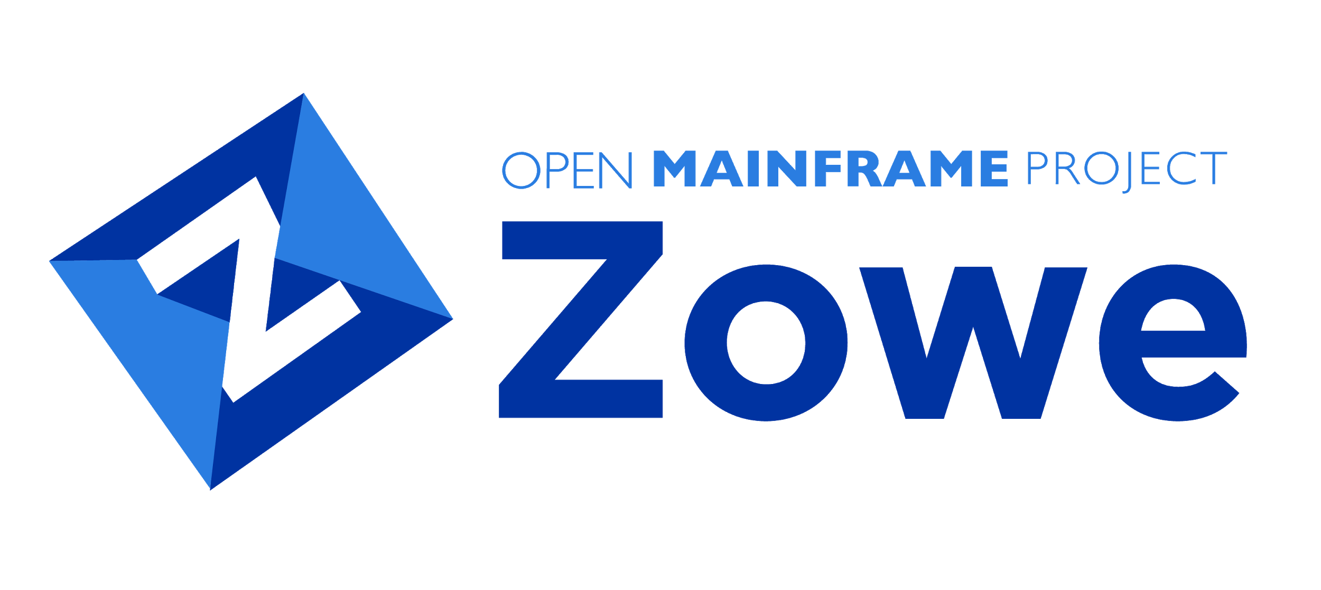
Zowe Joint Community 20PI3 (Q3) Survey
Project Managers: Nick Kocsis, Nolan Rogers, Kyle Woodworth
Notes:
Speaker - ?

Slide 2
Question 1 (What role did you play in the Joint PI Planning?)
Most of the Attendees were Squad Committers
Other Responses:
ZLC
Squad Leader, Squad committer, ISV (Broadcom)
Notes:
Speaker - Sujay

Slide 3
Question 2 (On a scale on 1-5 (5 the highest value) Did the joint PI planning provide value to you? if 1 or 2 please say why)
Overall feedback was positive
Most people were pleased to see a unified plan
Some suggestions were offered on how we could shorten the PI Planning
Notes:
Speaker - Sujay

Slide 4
Question 2 (On a scale on 1-5 (5 the highest value) Did the joint PI planning provide value to you? if 1 or 2 please say why) (Continued)
Responses
It's good to see the high-level unified direction for all Zowe squads. Having members of the ZLC in squad breakouts was very helpful.
I thought having the joint PI planning was awesome and will help different Zowe squads to work together.
Personally, I felt I understood the PI plans before the Zowe planning due to internal planning. Therefore, the Zowe planning could have been condensed to a single day IMO. I did find some of the squad breakout sessions to be valuable.
It was great to have all of the squads involved in a single PI planning event. It provided visibility into the direction of the solution.
The meetings are very long and tie up everyone for a long time. Could this be reduced by submitting proposals (of content, duration, etc.) beforehand, and by splitting off sub-groups of interested parties once a direction has been established? The 'meeting' should be just to obtain consensus and rubber-stamp the choices.
Even if things could be better, it was unquestionably good to try to align things & understand the directions.
It was great to get an understanding of what work teams were planning to pick up, especially on the cross-squad work
Notes:
Speaker - Sujay

Slide 5
Question 3 (Do you believe the main objectives, risks, and collaboration were clearly addressed in the PI Planning?)
Almost 94% of the PI Planning participants felt that their objectives were met
Notes:
Speaker - Sujay

Slide 6
Question 4 (Did you get the participation you wanted on the Squads calls ? if no, please explain.)
Comments:
Not enough time to attend all the sessions - some at conflicting times
It would have been beneficial to have time for breakout sessions for squads that have overlap e.g. Zowe CLI and Zowe Explorer
Many people are on more an one squad so the squad breaks were great but would be even better with fully participation
Notes:
Speaker - Sujay

Slide 7
Question 5 (Were there any communication or technical problems (not knowing where the calls where or could not join them) with the PI?)
Comments
No, but I did not try to track all the meetings
I think in this first PI planning, it became clear that the draft/final plan review did not have to be scheduled for such a long duration. Squad breakouts could be scheduled at that most convenient time instead.
For one of the CLI Squad planning calls, couldn't join the Zoom call because community account for hosting Zoom meetings was in use by someone else. This wasn't a big deal though, was quickly reached out to with a Webex link to use as an alternative :)
We had a small issue with our Zoom account (Zoom suggested it was already in use) but were able to overcome it.
Only communication problems that arose involved individuals who are in two or more squads. They were unable to be present for all squads they are involved in, and therefore had less say in each squad's PI objectives.
I knew where my calls were, but the schedule was such that I couldn't attend other squads even if I wanted to. But, attending multiple would take many many hours, so that is another concern about doing so much planning in advance.
Notes:
Speaker - Sujay

Slide 8
Question 6 (Any other comments ?)
Pre-PI survey was helpful but needs to be done earlier and reviewed before going out
Overall, I thought the length of the PI Planning event was sufficient (1.5 days). I also like how all the squad PI objectives are easily accessible in GitHub.
Survey: Appreciate the creation of the survey that was sent out to the community in general. Would be nice to have Squad leads and teams create surveys too. - Would be nice if some multiple-choice questions could allow multiple answers.
Meetings: Time zones (other than EST) should be taken into consideration. It makes planning extremely difficult having to coordinate meeting times across the globe. (for instance, PDT and CET are 9 -10 hours apart)
There's a little disagreement about which goalposts we will reach in high availability theme, but we agree it's good to start the work. I don't think this harms productivity, but people must set expectations on what the outcome will be.
Notes:
Speaker - Sujay

Slide 9
Analysis of Survey Results
Pros:
Good high-level unified direction for Zowe
Helpful to have ZLC members in squad breakouts
Good to see other squads work which helped with dependencies
Pre-PI survey was helpful but needs to be done earlier
Length of PI was sufficient
Cons:
Need staggered breakout sessions so that everyone can attend
Need to include ”Innovation” into the schedule
Zoom account scheduling issues
Need to review the schedule of the upcoming PI
Reduce time by submitting proposals beforehand so interested parties are able to know what to expect
Notes:
Speaker - Bruce

Slide 10
Thank You

